Slide 1
IBM University Engagement Project Submission
“Exploring the Power of Machine Learning with IBM Cloud”

Slide 2
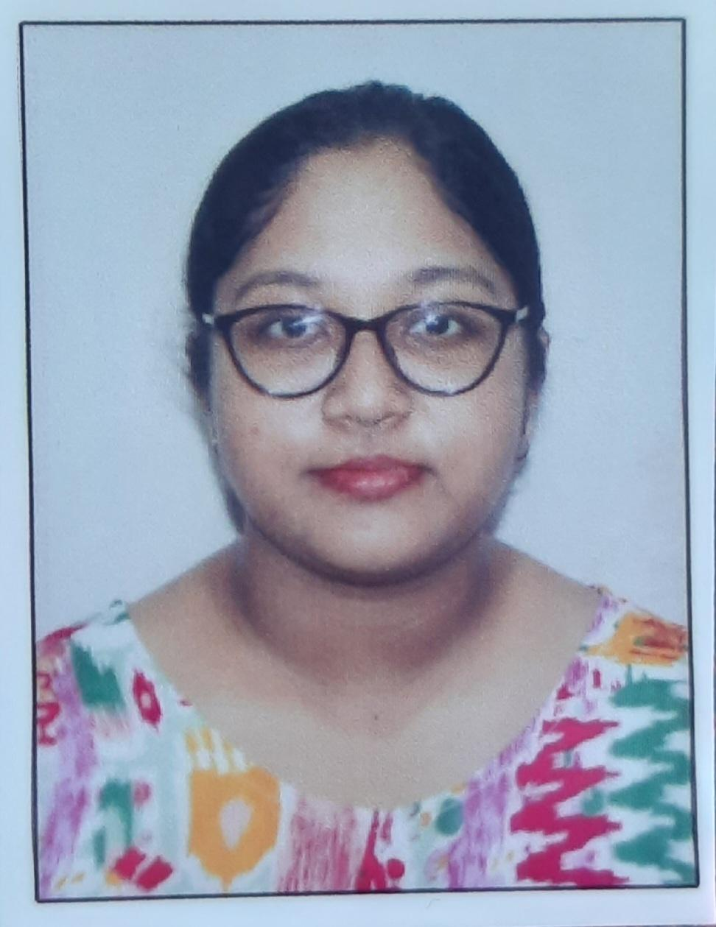
Project Tile – AI Agent for Smart Farming Advice
Domain of Project – Agriculture
Student Name | Recent Passport Photo | Email ID | Mobile number [WhatsApp]
PRIYANKA DEY |  | priyankadey200513@gmail.com | 6290448364

Slide 3
Problem Statement -
Problem Statement: AI Agent for Smart Farming Advice
– An AI Agent for Smart Farming Advice, powered by RAG (Retrieval-Augmented Generation), supports small-scale farmers by delivering real-time, localized agricultural guidance. It retrieves trusted data on weather forecasts, soil conditions, crop recommendations, pest control measures, and current market prices from agricultural departments, meteorological sources, and agri-tech platforms.
Farmers can interact in their local language and ask questions like “What crop is best for this season?” or “What is today’s mandi rate for tomatoes?”
The agent ensures timely, data-driven decisions that reduce risk, increase yield, and boost income.
This AI-driven assistant bridges the knowledge gap and brings smart farming to the grassroots.

Slide 4
Project Workflow -
Farmer
│
▼
Enter Soil & Weather Parameters
│
▼
Random Forest Model
│
▼
Recommended Crop
│
▼
IBM watsonx.ai (Llama 3.3)
│
▼
AI Farming Guide

Slide 5
Proposed Solution -
Developed a Machine Learning-based crop recommendation system using Random Forest Classifier.
Trained the model on the Crop Recommendation Dataset containing soil and climatic parameters.
Built an interactive Streamlit web application for user interaction.
Integrated IBM watsonx.ai foundation model (Meta Llama 3.3 70B Instruct) to generate detailed farming guidance.
The application provides crop prediction followed by AI-generated recommendations on soil, fertilizers, irrigation, diseases, pest management, and government schemes.

Slide 6
Technology Used
IBM Cloud: IBM Cloud Lite provides the cloud platform for deploying and accessing IBM watsonx.ai foundation models.
IBM watsonx.ai: Used to generate AI-powered agricultural recommendations.
IBM BOB (Build on IBM): Assisted in project development by providing coding guidance, debugging support, and implementation recommendations during the development of the Smart Farming AI application.
ML Algorithm / Model Used: Random Forest Classifier
Python Libraries Used: Pandas, Scikit-learn, Streamlit
Accuracy Obtained: 99.55%
Enhancements and Hyperparameter Tuning:
Feature preprocessing
Model evaluation
Random Forest optimization
Model serialization using Joblib

Slide 7
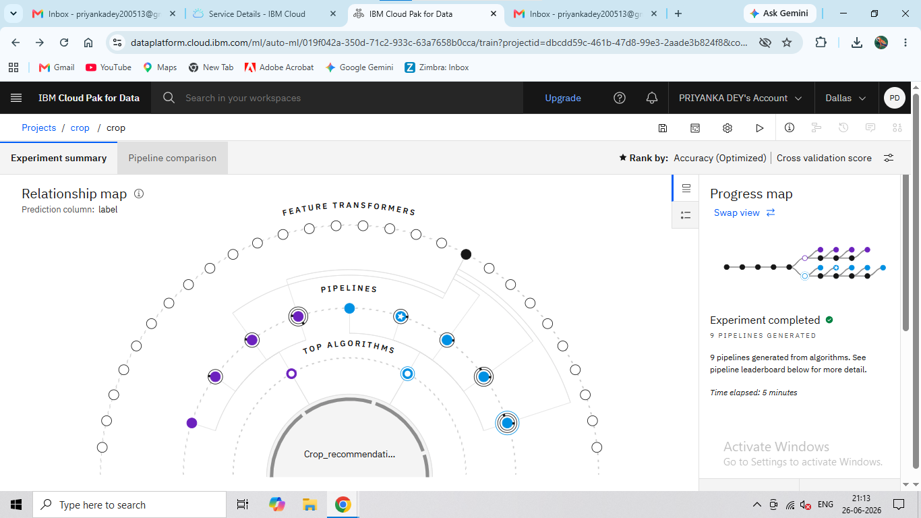
Training Screenshots -

Slide 8
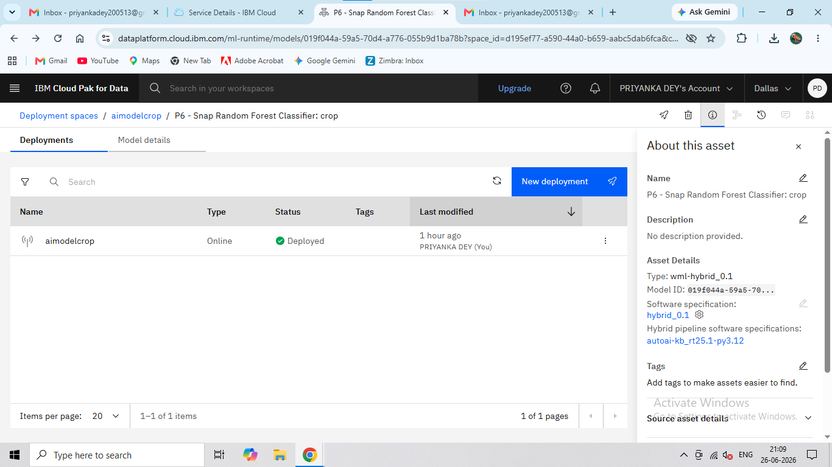
Training Screenshots -

Slide 9
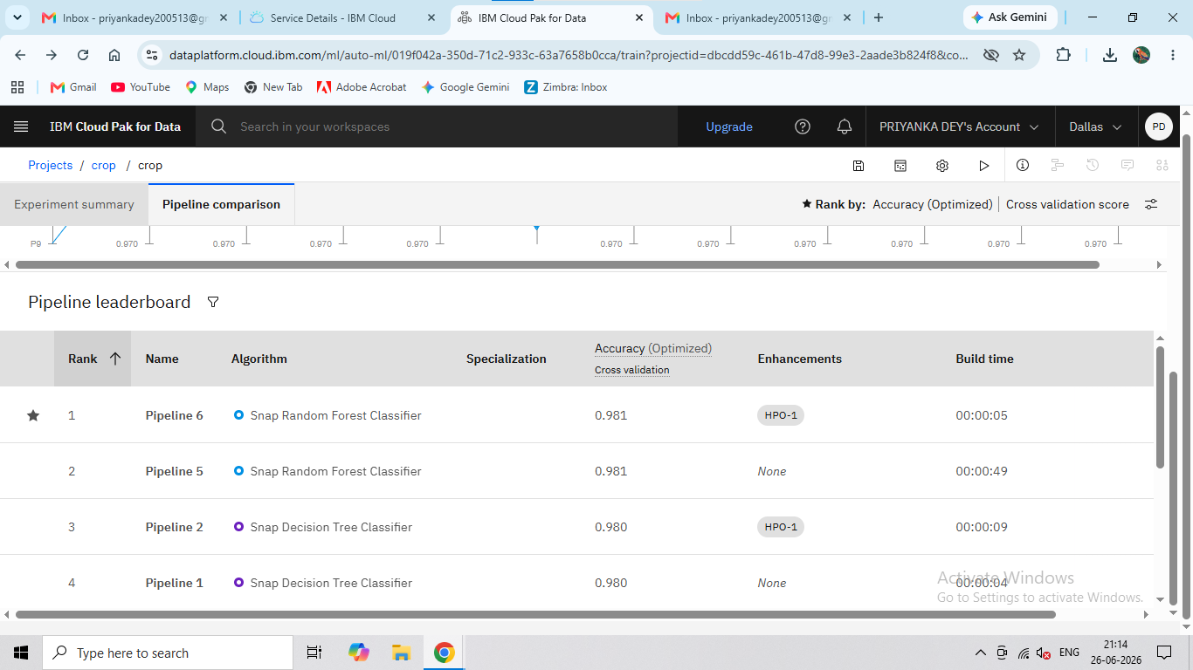
Best Model Screenshot -

Slide 10
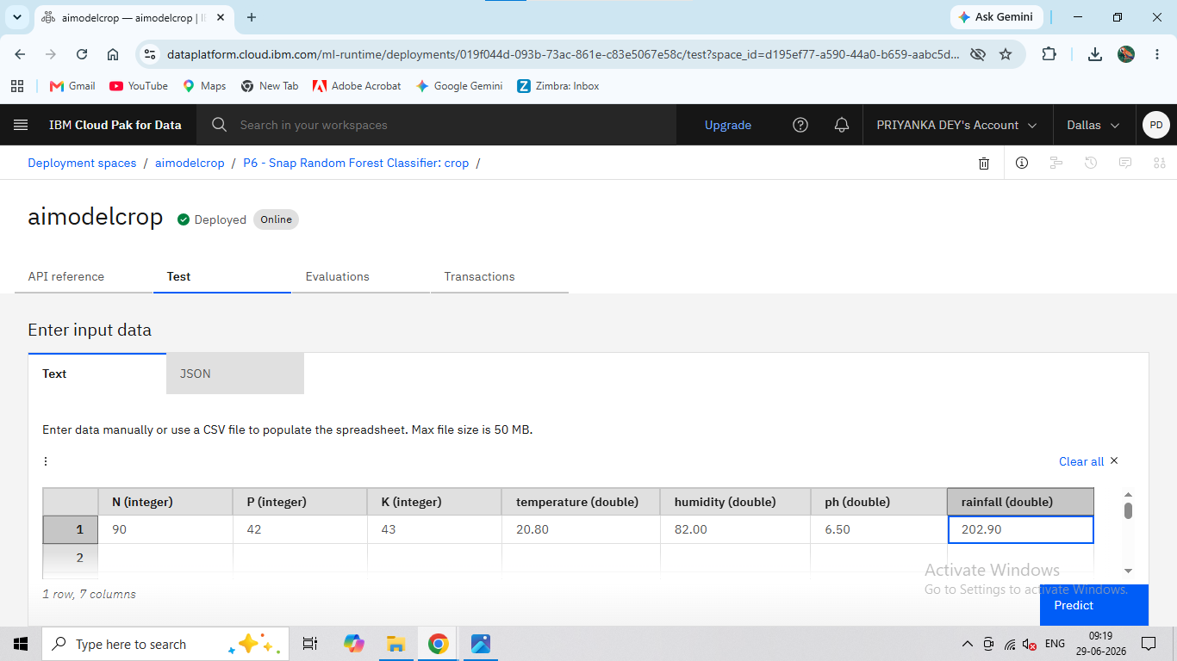
Testing Screenshot -

Slide 11
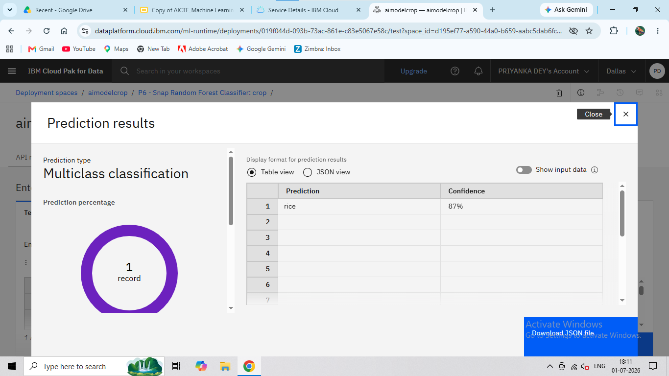
Testing Screenshot -

Slide 12
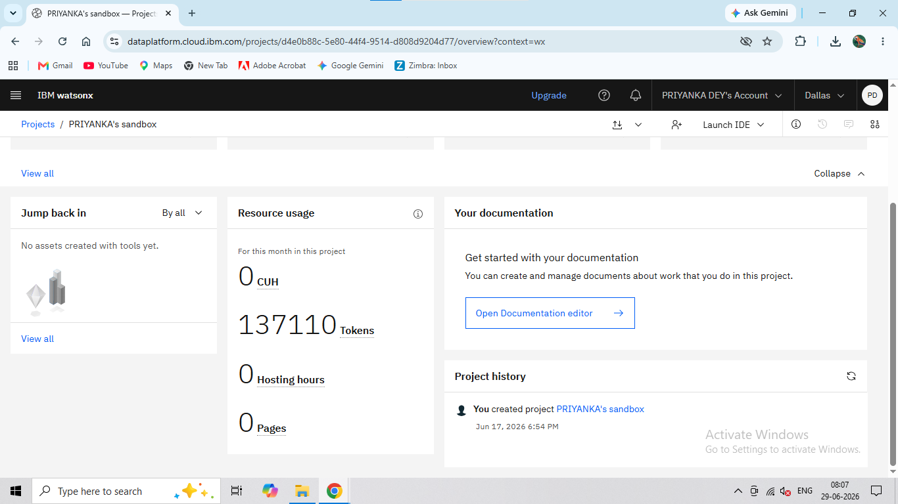
IBM watsonx.ai Project - Project overview showing the IBM watsonx.ai environment used to build and manage the Smart Farming AI solution.

Slide 13
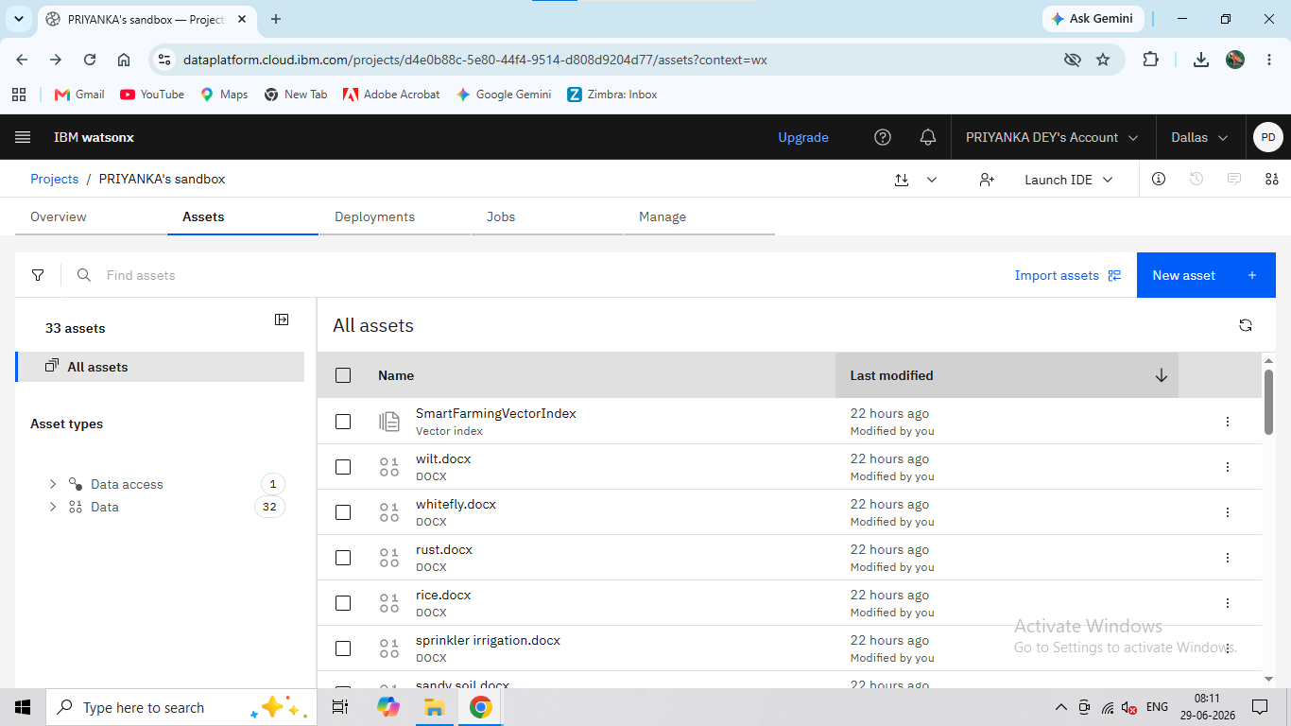
SmartFarmingVectorIndex Created with 32 Agricultural Documents - A vector index was created using 32 curated agricultural documents covering crops, soil, fertilizers, irrigation, pests, diseases, and government schemes.

Slide 14
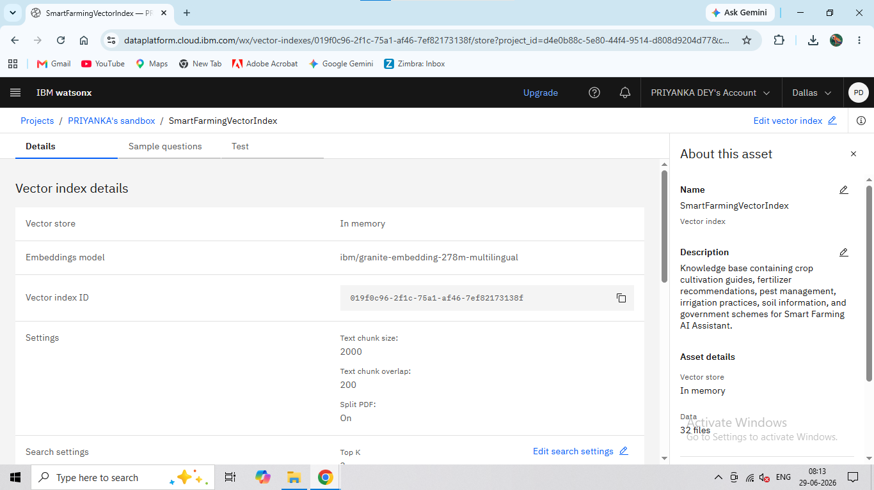
SmartFarmingVectorIndex Configuration and Knowledge Base - Vector index configuration showing the embedding model, chunking settings, and knowledge base details.

Slide 15
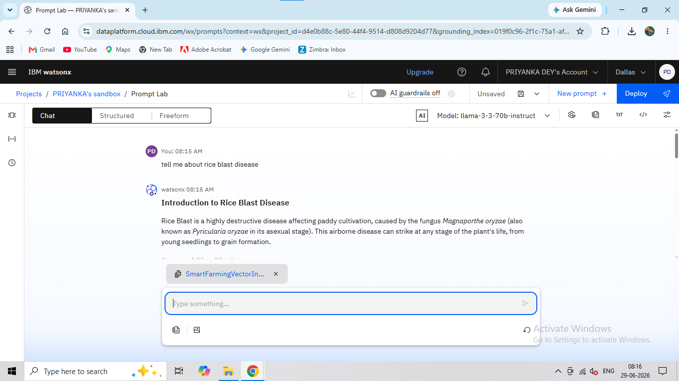
Testing the Knowledge Base in IBM Prompt Lab - A sample agricultural query was submitted through Prompt Lab with document grounding enabled.

Slide 16
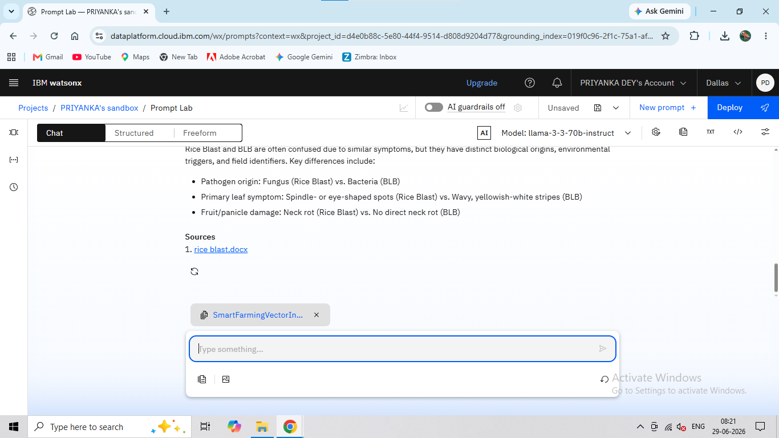
Grounded Response Generated Using SmartFarmingVectorIndex - IBM watsonx.ai generated an answer using the uploaded agricultural documents, with the source document cited in the response.

Slide 17
Training Process -
The crop recommendation model was developed using the Crop Recommendation Dataset containing soil nutrients (Nitrogen, Phosphorus, Potassium) and environmental parameters such as temperature, humidity, pH, and rainfall.
The dataset was preprocessed and divided into training and testing sets. A Random Forest Classifier was trained using Scikit-learn and evaluated for prediction accuracy. The trained model achieved an accuracy of 99.55% and was saved as model.pkl using Joblib for integration into the Streamlit application.
The detailed implementation, dataset, and training results are shown in the following slides.

Slide 18
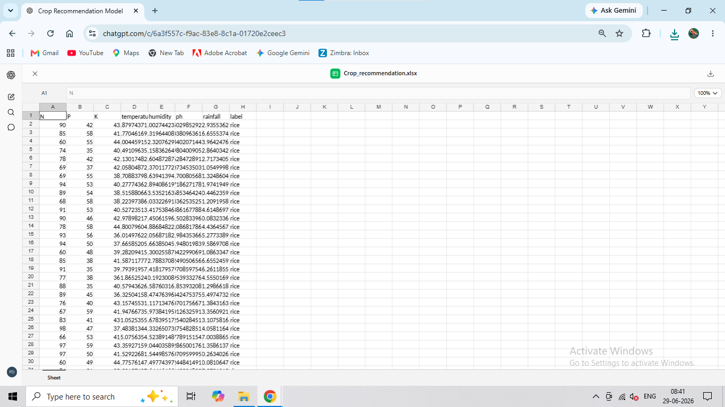
Training Dataset - The dataset consists of agricultural and environmental features with crop labels, forming the basis for training and evaluating the crop recommendation.model

Slide 19
Choosing the Best Model -
The Crop Recommendation Dataset was evaluated using machine learning techniques to identify the most suitable algorithm for accurate crop prediction. Among the models tested, the Random Forest Classifier delivered the best performance with an accuracy of 99.55%.
The model effectively learned the relationship between soil nutrients (Nitrogen, Phosphorus, Potassium) and environmental parameters (temperature, humidity, pH, and rainfall) to recommend the most suitable crop. Owing to its high accuracy, robustness, and ability to generalize well on unseen data, the Random Forest model was selected as the final prediction model.
The trained model was then saved as model.pkl using the Joblib library and integrated into the Streamlit-based Smart Farming AI application for real-time crop prediction.

Slide 20
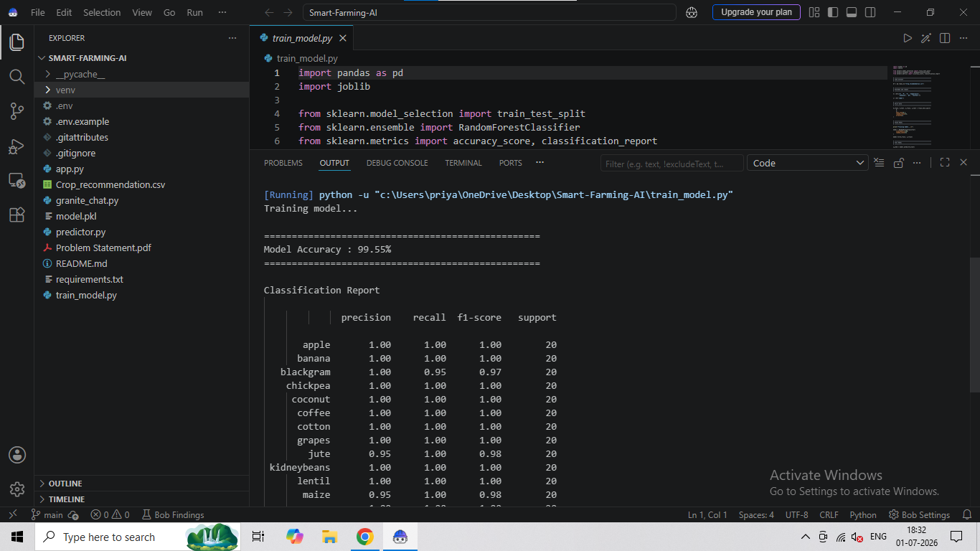
Random Forest Model Training Results - The Random Forest Classifier achieved an accuracy of 99.55% during model evaluation. The trained model was successfully saved as model.pkl for integration into the Smart Farming AI application.

Slide 21
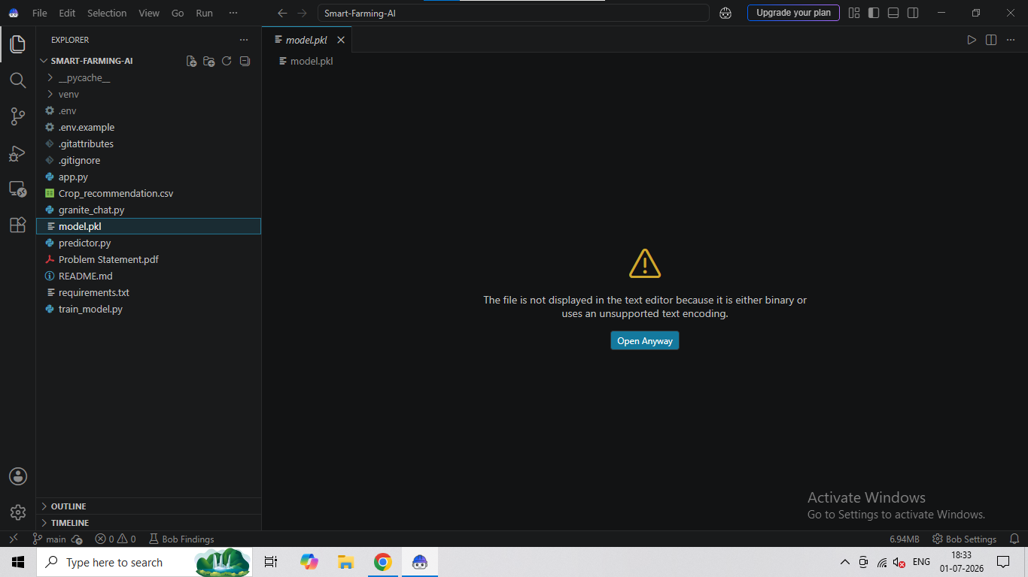
Trained Machine Learning Model (model.pkl) - The trained Random Forest model was successfully saved as model.pkl using the Joblib library. This serialized model is loaded by the Streamlit application to perform real-time crop prediction based on user-provided soil and environmental parameters.

Slide 22
Application Testing -
The developed Smart Farming AI application was tested using different combinations of soil nutrients and environmental parameters to validate the performance of the trained Random Forest model. The application successfully predicted the most suitable crop based on the input values and displayed the recommendation through an interactive Streamlit interface.
After generating the crop prediction, the application uses IBM watsonx.ai (Meta Llama 3.3 70B Instruct) to provide a comprehensive farming guide. The AI-generated response includes recommendations on suitable soil, fertilizer usage, irrigation practices, disease management, pest control, and relevant government schemes for the predicted crop.
The following slides present screenshots of the application interface, crop prediction results, and AI-generated farming guidance.

Slide 23
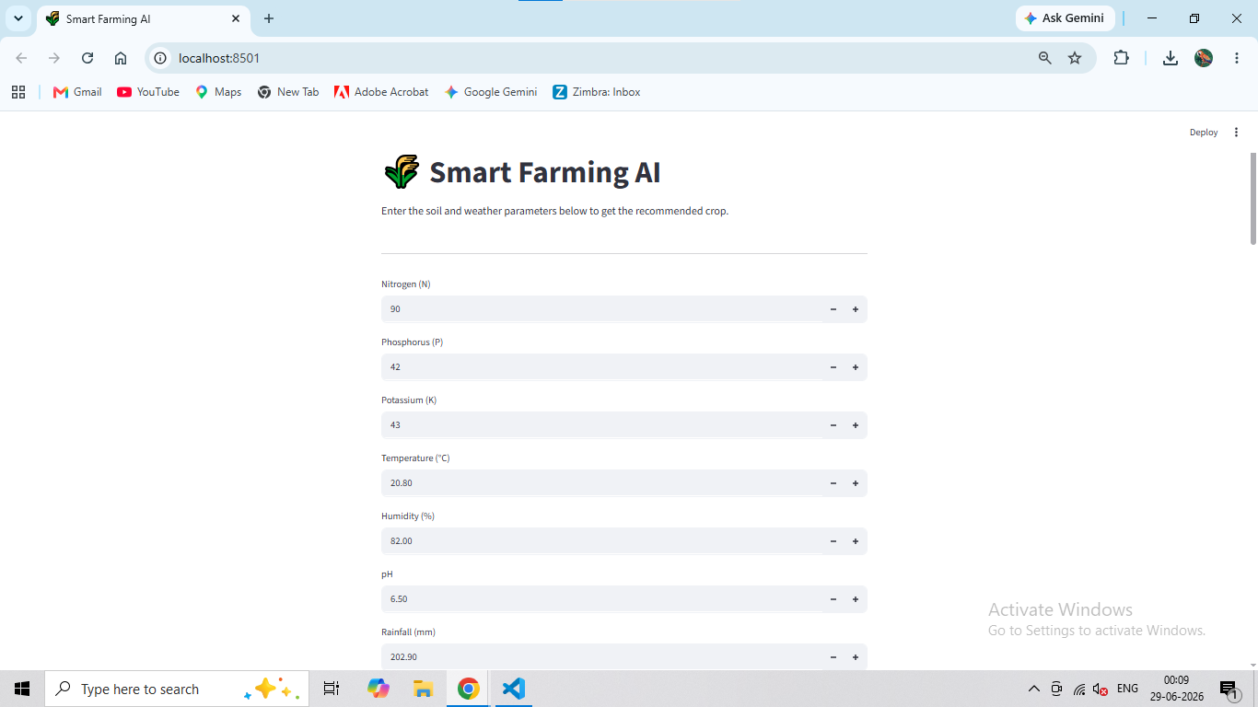
Crop Prediction Result -

Slide 24
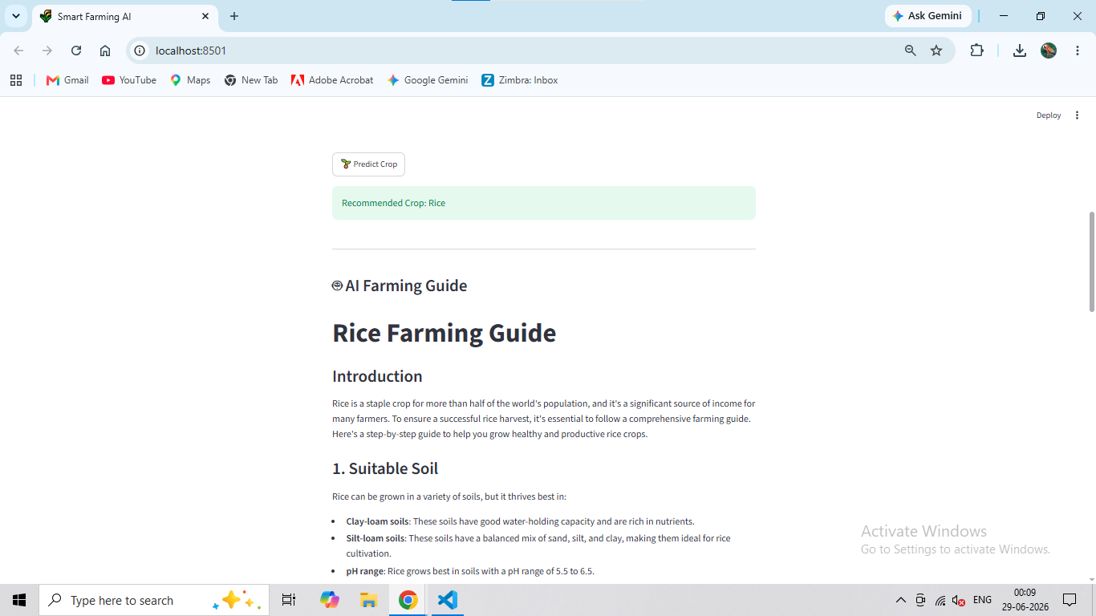
Crop Prediction Result -

Slide 25
Novelty and Uniqueness
The Smart Farming AI Agent combines traditional Machine Learning with Generative AI to provide intelligent, data-driven agricultural assistance. Unlike conventional crop recommendation systems that only predict a suitable crop, this solution extends its capabilities by generating comprehensive farming guidance using IBM watsonx.ai (Meta Llama 3.3 70B Instruct).
The application first analyzes soil nutrients and environmental conditions using a Random Forest Classifier with an accuracy of 99.55% to recommend the most suitable crop. It then leverages IBM watsonx.ai to generate practical recommendations covering suitable soil, fertilizer usage, irrigation methods, disease management, pest control, and relevant government schemes.
The system provides farmers with an easy-to-use Streamlit interface that delivers personalized agricultural guidance in a single platform. By combining predictive analytics with AI-powered advisory services, the project supports informed decision-making, improves farming productivity, and demonstrates the effective use of IBM Cloud Lite services and IBM watsonx.ai in smart agriculture.

Slide 26
Git Hub Link -
Click Here: https://github.com/priyankad9919/Smart-Farming-AI
·
·
·

Slide 27
Future Scope -
Integrate real-time weather forecasting APIs to provide location-specific farming recommendations.
Develop a mobile application for easy access to farming advice anytime and anywhere.
Implement image-based crop disease detection using computer vision and deep learning techniques.
Continuously update the system with the latest government schemes, agricultural policies, and best farming practices.
·
·
·

Slide 28
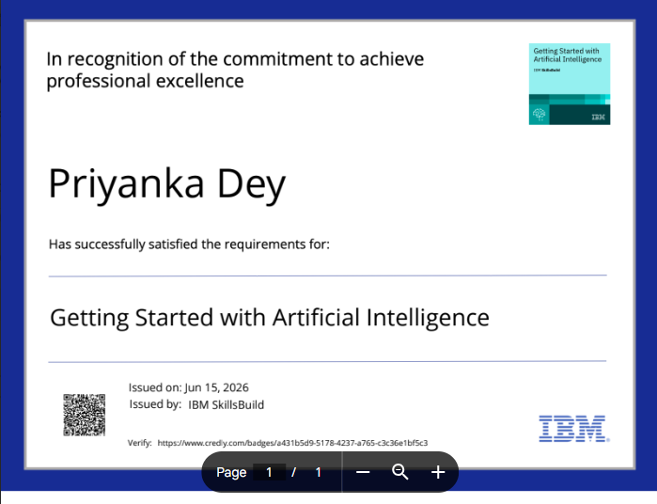
Certificates Earned -

Slide 29
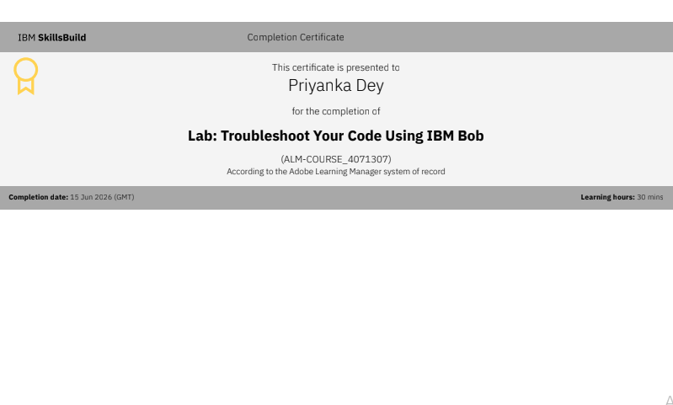
Certificates Earned -

Slide 30


